Slide 1
Instructions Formats

Slide 2
Instruction
Definition:
  Instruction is a statement by which the operation of CPU is determined.
  These instructions referred as “Machine instructions or computer Instructions”
  The collection of different instructions that the CPU can execute is referred to as the CPU’s instruction set.

Slide 3
What must an instruction set specify…?

Slide 4
Which Operation to perform
Where to find the operand or operands
Where to put the result, if there is result
Where to find the next instruction

Slide 5
Instruction Representations
Each instruction is represented by sequence of bits
The instruction is divided into two fields
  Opcode field
  Operand field
This operand field further divided into one to four fields.
This layout of the instruction is known as the “Instruction Format”
Simple instruction format
Opcode
Operand
Address1
Operand
Address2
Result
Address1
Next
Instruction

Slide 6
Instruction Set category
Instruction Set is categorized into types based on
  Operation performed
  number of operand addresses
  and addressing modes.

Slide 7
Based on number of operand address in the instruction.
    4 Address Instruction
    3 Address Instruction
    2 Address Instruction
    1 Address Instruction
    0 Address Instruction

Slide 8

How to Evaluate the Arithmetic statement in ZERO,ONE,TWO,THREE Address
SYMBOLS- ADD,SUB,MUL,DIV for arithmetic operations
MOVE –for Transfer type Operation
LOAD and STORE for transfers to and from Memory and AC registers

Slide 9
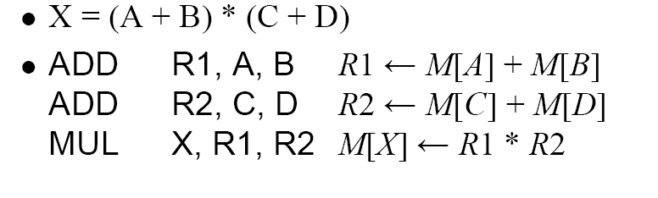
Three Address Instruction
Each address field to Specify either a
Processor Register or Memory Operand
Eg: Cyber 170

Slide 10
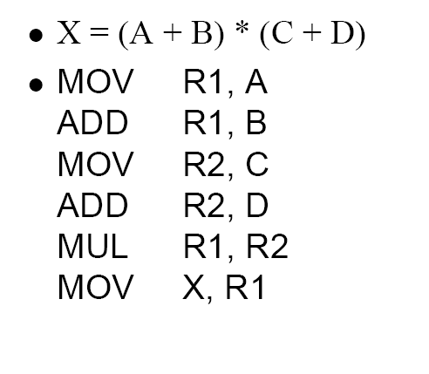
Two Address Instruction
Move Instruction
Moves or transfers
the operands to
and from memory
And processor
Registers

Slide 11
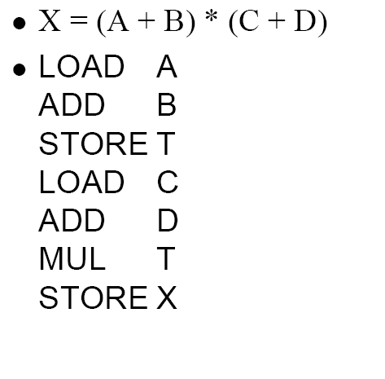
One Address Instruction
USES AC
Accumulator reg
AC <- M[A]
AC <- AC+ M[B]
M[T]<- AC
AC <- M [C]
AC<- AC+ M[D]
AC <- AC * M[T]
M[X]<- AC
T -Temporary Location

Slide 12
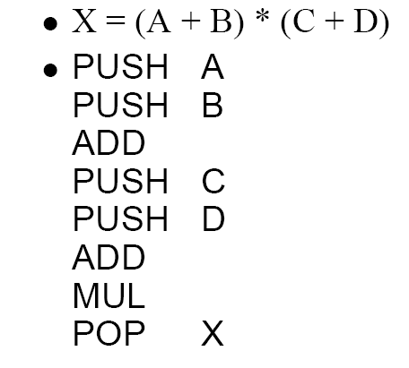
Zero Address Instruction
Do not use
Address Field for
Instruction
TOS<- A
TOS <-B
TOS<- A+B
TOS<- C
TOS<-D
TOS<-C+D
TOS<-(C+D)* (A+B)
M[X]<- TOS

Slide 13
Calculation of Memory traffic
Assumptions
  24-bit memory address (3 bytes)
  128 instructions (7 bits rounded to 1 byte)

Slide 14





4- Address Instruction
Memory
24 Bits / 3 Bytes
8
24
24
24
24
Op Code
ResAddr
Op1Addr
Op2Addr
NextiAddr
Op Code
ResAddr
Op1Addr
Op2Addr
NextiAddr
CPU
Op1
Example: add M1,M2,M3, nexti
M(1)←M(2)+M(3)
Op2
+
Resop
Memory Required to Encode an Instruction:
1Byte+ 4 x 3 bytes = 13 Bytes
Calculation of Memory Accesses
To fetch Instruction itself
To Execute an Instruction
Opcode=1
Op1Addr=1
Op1=1
Op2Addr=1
Op2=1
ResAddr=1
Res=1
NextiAddr=1
Total=3
Total=5
Total Memory Traffic= No. of M/A to fetch + No. of M/A to Execute
Total Memory Traffic= 5 + 3 =8

Slide 15
4 –address Instruction
Because of the large instruction word size and number of memory accesses ,the 4- address machine and instruction format is not seen in the machine design.
Although the 4-address structure is used internally in some implementations of computer control units. This kind of controller implementations is known as micro
coded Control.

Slide 16
3- Address Instruction
Memory
24 Bits / 3 Bytes
8
24
24
24
Op Code
ResAddr
Op1Addr
Op2Addr
Op Code
ResAddr
Op1Addr
Op2Addr
CPU
Op1
Example: add M1,M2,M3
M(1)←M(2)+M(3)
Op2
+
Resop
Memory Required to Encode an Instruction:
1Byte+ 3 x 3 bytes = 10 Bytes
PC
24
Calculation of Memory Accesses
To fetch Instruction itself
To Execute an Instruction
Opcode=1
Op1Addr=1
Op1=1
Op2Addr=1
Op2=1
ResAddr=1
Res=1
Total=4
Total=3
Total Memory Traffic= No. of M/A to fetch + No. of M/A to Execute
Total Memory Traffic= 4+ 3 =7

Slide 17
3-Address instruction:
  Address of next instruction kept in processor state register—the PC (Except for explicit Branches/Jumps)
  Rest of addresses in instruction
  This Instruction will require 3X3+1= 10 bytes to encode a 3-address ALU instruction.
  The number of memory access are required for a 3-address instruction:
  Four words will be transferred to the CPU when the instruction itself is fetched.= 4
  Then the two words representing the operands themselves need to be fetched into the CPU = 2
  And after the addition has been performed, the result needs to be written back to memory = 1
Total =07

Slide 18
2- Address Instruction
Memory
24 Bits / 3 Bytes
8
24
24
Op Code
Op1Addr
Op2Addr
CPU
Op Code
Op1Addr
Op2Addr
Example: add M2,M3
M(2)←M(2)+M(3)
Op1
Op2
+
Memory Required to store an Instruction:
3 x 3 bytes = 09 Bytes
Resop
Memory Required to Encode an Instruction:
1Byte+ 2 x 3 bytes = 7 Bytes
PC
24
Calculation of Memory Accesses
To fetch Instruction itself
To Execute an Instruction
Opcode=1
Op1Addr=1
Op1=1
Op2Addr=1
Op2=1
Res=1
Total=3
Total=3
Total Memory Traffic= No. of M/A to fetch + No. of M/A to Execute
Total Memory Traffic= 3+ 3 =6

Slide 19
2-address Instruction :
  Result overwrites Operand 2
  Needs only 2 addresses in instruction but less choice in placing data
  This Instruction will require 2X3+1= 7 bytes to encode a 2-address ALU instruction.
  The number of memory access are required for a 2-address instruction:
  Three words will be transferred to the CPU when the instruction itself
is fetched. = 3
  Then the two words representing the operands themselves need to be fetched into he CPU and after the addition has been performed, Result overwrites Operand =3
  Total= 06
  add Op1Addr Op2Addr

Slide 20
1- Address Instruction
Memory
24 Bits / 3 Bytes
8
24
Op Code
Op1Addr
CPU
Op Code
Op1Addr
Op1
Example: add M2
Op2
+
Resop
Memory Required to Encode an Instruction:
1Byte+ 1 x 3 bytes = 4Bytes
Acc
PC
24
Calculation of Memory Accesses
To fetch Instruction itself
To Execute an Instruction
Opcode=1
Op1Addr=1
Op1=1
Total=2
Total=1
Total Memory Traffic= No. of M/A to fetch + No. of M/A to Execute
Total Memory Traffic= 2+ 1 =3

Slide 21
1-address Instruction :
  Special CPU register, the accumulator, supplies 1 operand and stores result
  One memory address used for other operand
  Need instructions to load and store operands:
    LDA OpAddr
    STA OpAddr
This Instruction will require 1X3+1= 4 bytes to encode a 1-address ALU instruction
The number of memory access are required for a 1-address instruction:
  Two words will be transferred to the CPU when the instruction itself is fetched = 2
  Then the one word representing the operand itself need to be fetched into
the CPU register and the accumulator, supplies 1 operand and stores
result = 1
  Total=03

Slide 22
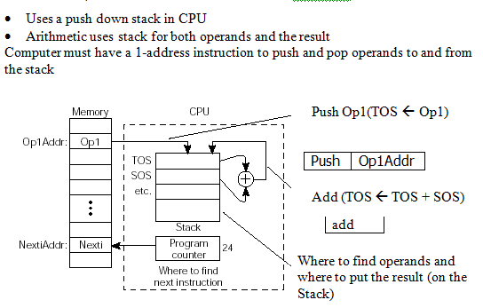
0-Address Instruction

Slide 23
Comparisons
Instruction Type | Memory To Store in Bytes | Memory To Encode in Bytes | M/As to fetch an Instruction | M/As to Execute an Instruction | Memory Traffic
4-address | 5 x 3 = 15 | 1+(4 x 3) = 13 | 5 | 3 | 5+3=8
3-Address | 4 x 3 = 12 | 1+(3 x 3) = 10 | 4 | 3 | 4+3=7
2-Address | 3 x 3 = 09 | 1+(2 x 3) = 07 | 3 | 3 | 3+3=6
1-Address | 2 x 3 = 06 | 1+(1 x 3) = 04 | 2 | 1 | 2+1=3
0-Address | 1 x 3 = 03 | 1+(0 x 3) = 01 | 1 | 0 | 1+0=1

Slide 24
Problems
Evaluate a = (b+c)*d – e in 3-, 2-, 1-, 0- address machines and compute the memory traffic. Assume 24 bit memory address and one byte opcode.
3-address | 2-address | 1-address | 0-address
add a,b,c mul a,a,d sub a,a,e | load a,b Add a,c Mul a,d Sub a,e | Load b Add c Mul d Sub e Store a | Push b Push c Add Push d Mul Push e Sub Pop a
Memory traffic for 3-address
Machine: 7 * 3 = 21
Memory traffic for 2-address
Machine: 6 * 4 = 24
Memory traffic for 1-address
Machine: 3 * 5 = 15
Memory traffic for 0-address
Machine: 3 * 5 + 3 = 18

Slide 25
Memory to Store | Memory to encode | M/As to Fetch | M/As to Execute | Memory Traffic
4*3=12 | 1+(3*3)=10 | 4 | 3 | 4+3=7
4*3=12 | 1+(3*3)=10 | 4 | 3 | 4+3=7
4*3=12 | 1+(3*3)=10 | 4 | 3 | 4+3=7
36 | 30 | 12 | 9 | 21
add a, b, c
a←b+c
mpy a, a, d
a←a*d
sub a, a, e
a←a-e
Memory to Store | Memory to encode | M/As to Fetch | M/As to Execute | Memory Traffic
3*3=9 | 1+(2*3)=7 | 3 | 2 | 3+2=5
3*3=9 | 1+(2*3)=7 | 3 | 3 | 3+3=6
3*3=9 | 1+(2*3)=7 | 3 | 3 | 3+3=6
3*3=9 | 1+(2*3)=7 | 3 | 3 | 3+3=6
36 | 28 | 12 | 11 | 23
load a, b
a←b
add a, c
a←a+c
mpy a, d
a←a*d
sub a, e
a←a-e

Slide 26
Memory to Store | Memory to encode | M/As to Fetch | M/As to Execute | Memory Traffic
2*3=6 | 1+(1*3)=4 | 2 | 1 | 2+1=3
2*3=6 | 1+(1*3)=4 | 2 | 1 | 2+1=3
2*3=6 | 1+(1*3)=4 | 2 | 1 | 2+1=3
2*3=6 | 1+(1*3)=4 | 2 | 1 | 2+1=3
2*3=6 | 1+(1*3)=4 | 2 | 1 | 2+1=3
30 | 20 | 10 | 5 | 15
load b
Acc←b
add c
Acc←Acc+c
mpy d
Acc←Acc*d
sub e
Acc←Acc-e
store a
a←Acc
push b
6 | 4 | 2 | 1 | 3
6 | 4 | 2 | 1 | 3
3 | 1 | 1 | 0 | 1
6 | 4 | 2 | 1 | 3
3 | 1 | 1 | 0 | 1
6 | 4 | 2 | 1 | 3
3 | 1 | 1 | 0 | 1
6 | 4 | 2 | 1 | 3
39 | 23 | 13 | 5 | 18
push c
add
push d
mpy
push e
sub
pop a

Slide 27
Based on Operation
Data Movement
  Memory I\O Instructions
    LOAD, STORE, MOV IN, OUT
Data Processing
  Arithmetic Logic Instructions
    Add, Sub, MUL AND, OR,
Control Instructions
  Conditional Un Conditional
    JNZ, JZ…. Jump

Slide 28
Evaluate the expression a = b - c * d and compute memory traffic for 3 and 1 address machine. Assuming that addresses are 16 bits, data values are 16 bits, opcodes are 8 bits and 1 byte word length. [8Marks]
Practice problem
Evaluate the expression a = b - c * d and compute memory traffic for 3, 2, 1,and 0 address machine. Assuming that addresses are 16 bits, data values are 16 bits, opcodes are 8 bits and 1 byte word length.

Slide 29
References
Reference Book
Vincent .P. Heuring, Harry F. Jordan “ Computer System design and Architecture” Pearson, 2nd Edition, 2003.
William Stallings “Computer Organization and architecture”, Prentice Hall, 7th edition, 2006.

